Slide 1

CSC348 – Data Security and Encryption
Dr. Adnan Ahmad
AdnanAhmad@ciitlahore.edu.pk

Slide 2
Block Ciphers and DES

Slide 3
Modern Ciphers
Stream Ciphers
Encrypts a digital data stream one bit or one byte at a time
One time pad is an example; but practical limitations
Typical approach for stream cipher:
Key (k) used as input to bit-stream generator algorithm
Algorithm generates cryptographic bit stream (k_{i}) used to encrypt plaintext
Users share a key; use it to generate key-stream

Slide 4
Modern Ciphers
Stream Ciphers

Slide 5
Modern Ciphers
Block Ciphers
Encrypt a block of plaintext as a whole to produce same sized ciphertext
Typical block sizes are 64 or 128 bits
Modes of operation used to apply block ciphers to larger plaintexts

Slide 6
Modern Ciphers
Block Ciphers
n-bit block cipher takes n-bit plaintext and produces n-bit ciphertext
Encryption must be reversible (decryption possible)
Each plaintext block must produce unique ciphertext block
Total transformations is 2^{n}

Slide 7
Modern Ciphers
An Ideal Block Cipher
n-bit input maps to 2^{n} possible input states
Substitution used to produce 2^{n} output states
Output states map to n-bit output
An ideal block cipher allows maximum number of possible encryption mappings from plaintext block

Slide 8
Modern Ciphers
Lets see an example
4-bit input = 16 different possible 4-bit patterns

Slide 9
Modern Ciphers
An Ideal Block Cipher
Problems with this ideal block cipher:
Small block size:
equivalent to classical substitution cipher; cryptanalysis based on statistical characteristics feasible
Large block size:
key must be very large; performance/implementation problems

Slide 10
The Feistel Structure for Block Ciphers
Named after the IBM cryptographer Horst Feistel (early 70’s) and first implemented in the Lucifer cipher by Horst Feistel and Don Coppersmith
Feistel proposed applying two or more simple ciphers in sequence so final result is cryptographically stronger than component ciphers
n-bit block length; k-bit key length; 2^{k} transformations
Feistel cipher alternates: substitutions, transpositions
Applies concepts of confusion and diffusion
Applied in many ciphers today

Slide 11
The Feistel Structure for Block Ciphers
Approach:
Plaintext split into two halves
Subkeys (or round keys) generated from key
Round function, F, applied to right half
Apply substitution on left half using XOR
Apply permutation by interchanging two halves

Slide 12
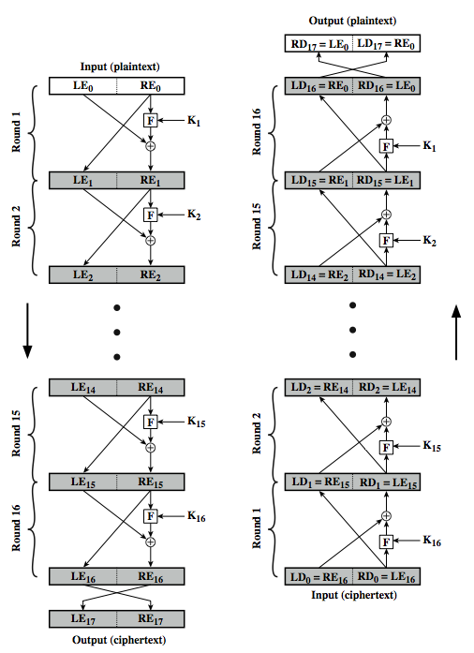
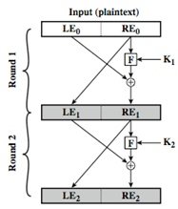
The Feistel Structure for Block Ciphers

Slide 13
The Feistel Structure for Block Ciphers
Diffusion
Statistical nature of plaintext is reduced in ciphertext
Output should be dependent on the input in a complex way
E.g. A plaintext letter affects the value of many ciphertext letters
One bit change in the input modifies 50% of the output.

Slide 14
The Feistel Structure for Block Ciphers
Confusion
Make relationship between ciphertext and key as complex as possible
Even if attacker can find some statistical characteristics of ciphertext, still hard to find key
Cannot find the key based on the ciphertext

Slide 15
The Feistel Structure for Block Ciphers
Using the Feistel Structure
Exact implementation depends on various design features
Block size, e.g. 64, 128 bits, larger values leads to more diffusion
Key size, e.g. 128 bits, larger values leads to more confusion, resistance against brute force
Number of rounds, e.g. 16 rounds
Subkey generation algorithm, should be complex
Round function F, should be complex
Other factors include fast encryption in software and ease of analysis
Tradeoff: security vs performance

Slide 16
Data Encryption Standard

Slide 17
Data Encryption Standard
One of most used encryption systems in world
Designed by IBM (Lucifer) with input from NSA
Adopted/published by National Bureau of Standards (NBS) now National Institute of Standards and Technology (NIST) in 1977
For commercial and unclassified government applications
Efficient hardware implementation
Electronic payment industry (ATM machines) uses DES
Microsoft OneNote, Outlook use DES to password protect user content and system data

Slide 18
Data Encryption Standard
Uses 56-bit key, 64-bit input block, 64-bit output block
The key itself is specified with 8 bytes, but one bit of each byte is used as a parity check
Uses the Feistel structure with 16 rounds
Specific to DES is;
Implementation of the F function (Mangler function) in the algorithm
How round keys are derived from the main encryption key
Round keys are generated from the main key by a sequence of permutations
Each round key is 48 bits in length

Slide 19
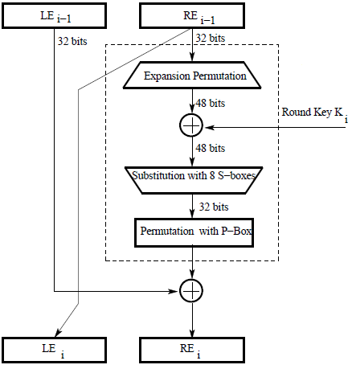
Data Encryption Standard
Single round of DES
DES
Mangler Function

Slide 20
Data Encryption Standard
The F Function
32-bit right half of the 64-bit input data block is expanded into a 48-bit block. This is referred to as the expansion permutation step (E-step)
56-bit key is permuted/contracted to yield a 48-bit round key
48 bits of the expanded output produced by the E-step are XORed with the round key. This is referred to as key mixing
Output (of the above step) is broken into eight 6-bit words. Each 6-bit word goes through a substitution step, where it is replaced with a 4-bit word. The substitution is carried out with an S-box
32-bit word (resulted from the above step) then go through a P-box based permutation

Slide 21
Data Encryption Standard
Single round of DES
DES
Mangler Function
Output from the F function is then XORed with the left half (32-bit) of the 64-bit input block
Output of this XORing operation gives the right half block for the next round
Left half of the next round is the right half of the previous round

Slide 22
Data Encryption Standard
The F Function
32-bit right half of the 64-bit input data block is expanded into a 48-bit block. This is referred to as the expansion permutation step (E-step)

Slide 23

Data Encryption Standard
Expansion permutation step (E-step)
Divide the 32-bit block into eight 4-bit words
Attach an additional bit on the left to each 4-bit word that is the last bit of the previous 4-bit word
Attach an additional bit to the right of each 4-bit word that is the beginning bit of the next 4-bit word

Slide 24
Data Encryption Standard
The F Function
Output (of the above step) is broken into eight 6-bit words. Each 6-bit word goes through a substitution step, where it is replaced with a 4-bit word. The substitution is carried out with an S-box

Slide 25
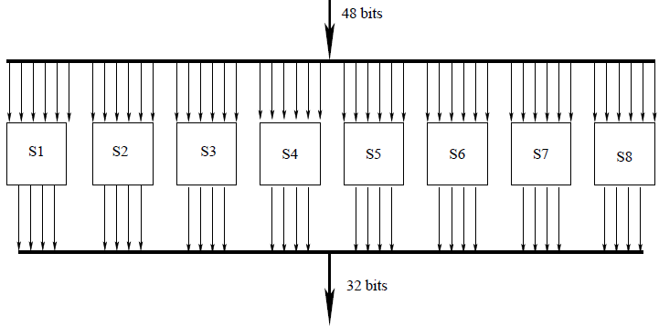
Data Encryption Standard
S-box substitution step
48-bit input word is divided into eight 6-bit words
Each 6-bit word fed into a separate S-box
Each S-box produces a 4-bit output
8 S-boxes together generate a 32-bit output

Slide 26
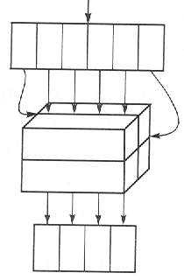
Data Encryption Standard
S-box substitution step
Each of the eight S-boxes consists of a 4×16 table lookup
First and last bit of each 6-bit input word are decoded into one of 4 rows and the middle 4 bits decoded into one of 16 columns for the table lookup
 | 0000 | 0001 | 0010 | 0011 | 0100 | 0101 | 0110 | 0111 | 1000 | 1001 | 1010 | 1011 | 1100 | 1101 | 1110 | 1111
00
01
10
11

Slide 27
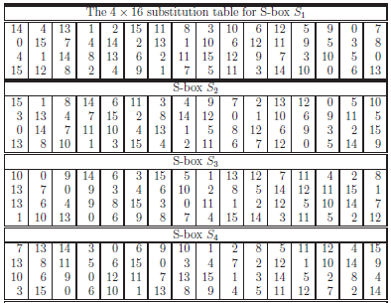
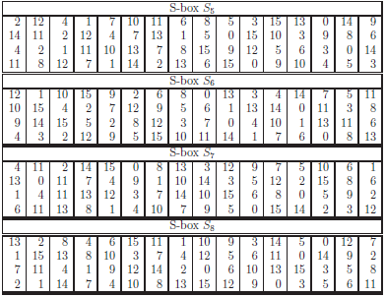
Data Encryption Standard
Eight S-boxes, S1 through S8

Slide 28
Data Encryption Standard
The F Function
32-bit word (resulted from the above step) then go through a P-box based permutation

Slide 29
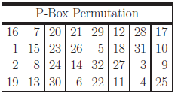
Data Encryption Standard
P-Box Permutation step
32-bit (output from previous step) goes through the last step which is permutation with P-Box
https://en.wikipedia.org/wiki/Permutation_box

Slide 30
Data Encryption Standard
The F Function
56-bit key is permuted/contracted to yield a 48-bit round key

Slide 31
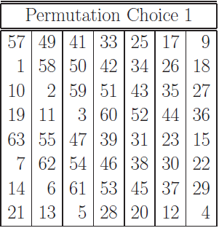
Data Encryption Standard
The DES Key: Generating the Round Keys
Initial 56-bit key may be represented as 8 bytes, with the last bit (the least significant bit) of each byte used as a parity bit
Relevant 56 bits are subject to a permutation at the beginning before any round keys are generated, referred to as Permutation Choice 1

Slide 32
Data Encryption Standard
The DES Key: Generating the Round Keys
At the beginning of each round
Divide the 56 relevant key bits into two 28-bit halves and circularly shift to the left each half by one or two bits, depending on the round
In rounds 1, 2, 9, and 16 rotate 1-bit left
In other rounds rotate 2-bit left

Slide 33
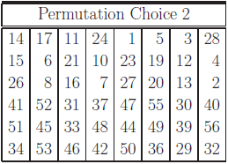
Data Encryption Standard
The DES Key: Generating the Round Keys
Join together the two halves and apply a 56 bit to 48 bit contracting permutation, referred to as Permutation Choice 2
Resulting 48 bits constitute round key
Two halves of the encryption key generated in each round are fed as the two halves going into the next round

Slide 34
Data Encryption Standard
What makes DES a strong cipher
Substitution step (diffusion) is very effective
It has been shown that if you change just one bit of the 64-bit input data block, on the average that alters 34 bits of the ciphertext block
Round keys generation from the encryption key (confusion) is also very effective
It has been shown that if you change just one bit of the encryption key, on the average that changes 35 bits of the ciphertext
Both effects are referred to as the avalanche effect

Slide 35
Data Encryption Standard
What makes DES a strong cipher
56-bit encryption key means a key space of size 2⁵⁶ ≈ 7.2 × 10¹⁶
On the average, you’d need to try half the keys in a brute-force attack
A machine able to process 1000 keys per microsecond would need roughly 13 months to break the code
However, a parallel-processing machine trying 1 million keys simultaneously would need only about 10 hours

Slide 36
Data Encryption Standard
DES was broken in 1999 by Electronics Frontiers Foundation (EFF)
EFF took 3 days on a specially designed machine to break the code (costs $ 250,000)
This resulted in NIST issuing a new directive the same year that required organizations to use Triple DES (3DES), that is, three consecutive applications of DES
3DES was found to be not as strong as originally believed
So, NIST initiated the development of new standards for data encryption and the result is Advanced Encryption Standard (AES)

Slide 37
Data Encryption Standard
Triple DES continues to enjoy wide usage in commercial applications even today
DES was broken because its short key size permits rapid key-search
But DES is a very strong design as evidenced by the fact that there are no practical attacks that exploit its structure

Slide 38
International Data Encryption Algorithm
IDEA is a block cipher designed by Xuejia Lai and James Massey of ETH Zurich in 1991
It is patented in a number of countries but can be used by anyone for non-commercial use
Operates on 64-bit blocks, using a 128-bit key
Eight identical transformations (rounds) and one output transformation (the half-round), a total of 8.5 rounds
Each of the eight round uses six sub-keys, while the half-round uses four
52 total sub-keys of 16-bit in length each

Slide 39
THANKS

